Slide 1

Introduction to WASP Eutro
BOD-DO
Algae & Nutrients

Slide 2
BOD-DO
Bottle Example
T.Harapan Example

Slide 3
Example 5.1
A bottle opened to reaeration and filled with polluted water has the following characteristics:
Find and c(t) after 86400 s.

Slide 4
Example 5.1 – Analytical Solution
(a) After 86400 s

Slide 5
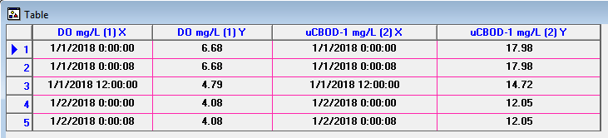
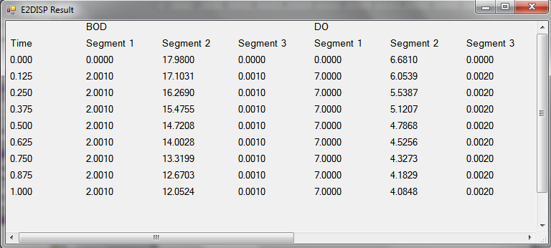
Example 5.1 – WASP & E2DISP

Slide 6
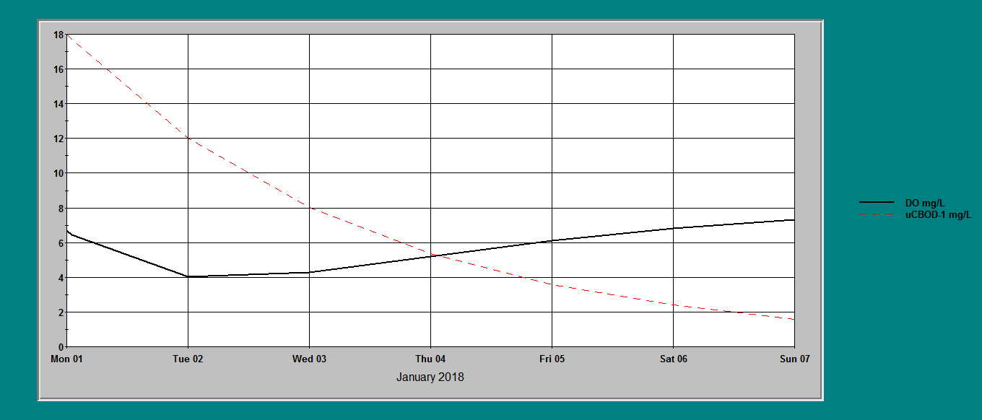
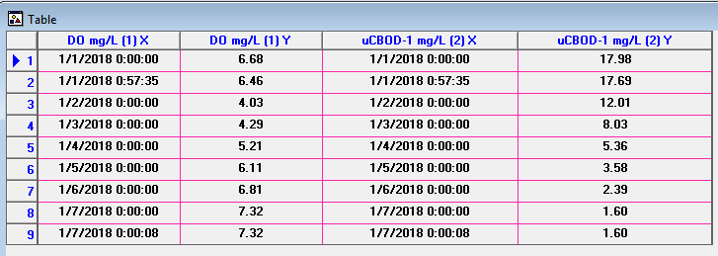
Example 5.1 – Longer Period

Slide 7
Tasik Harapan Example
(5.1)
(5.2)

Slide 8
Parameters values
Parameter | Symbol | Unit | Value
Reaeration rate | β | day⁻¹ | 1.00
DO saturation level | c_{s} | mg/l | 7.50
BOD decay rate | α | day⁻¹ | 0.2875
BOD loading | γ | mg/l/d | 2.30

Slide 9
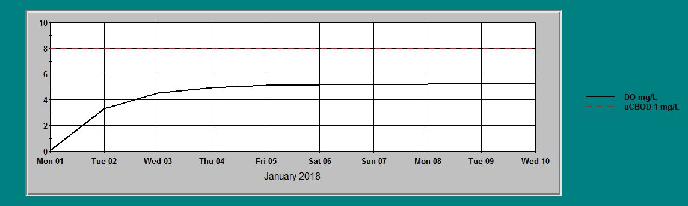
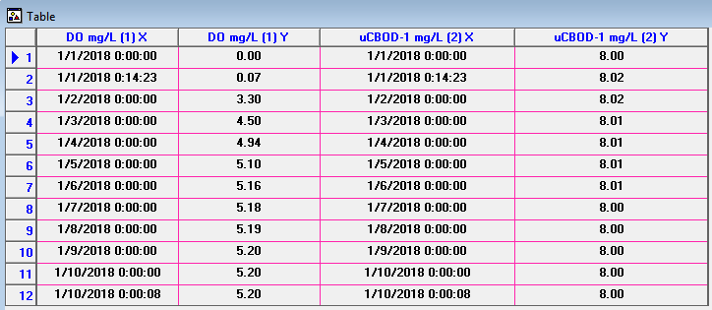
Tasik Harapan Example
Steady-state Solution:
BOD:
DO:

Slide 10
Algae & Nutrient
Tasik Harapan Example

Slide 11
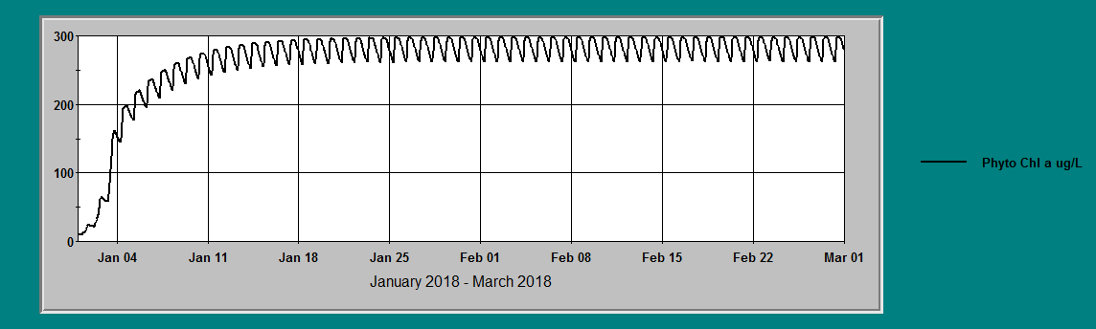
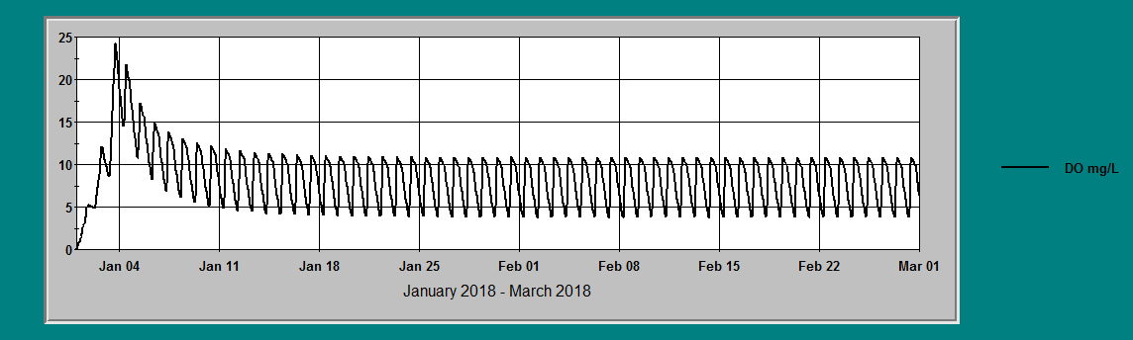
Chl a & DO

Slide 12
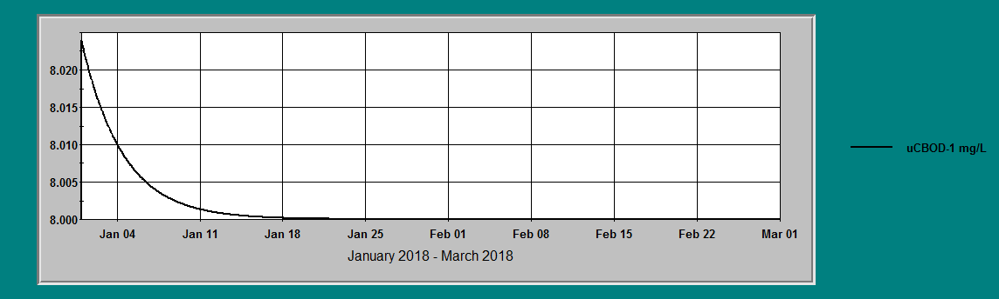
BOD

Slide 13
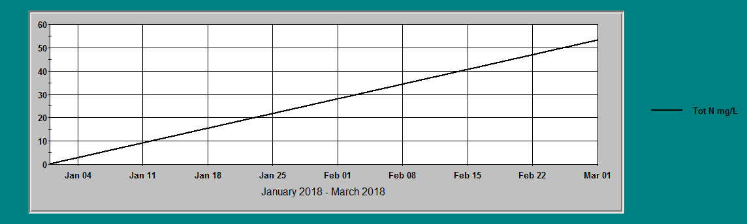
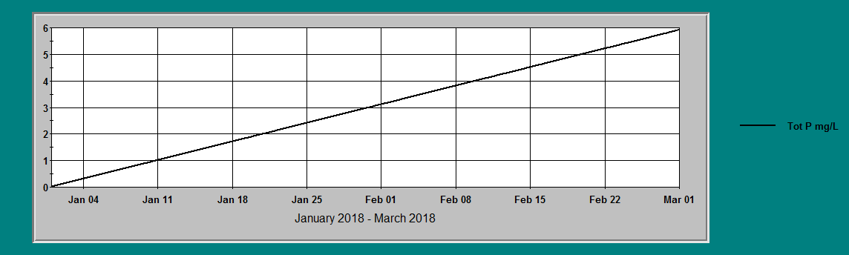
Nutrients

Slide 14
Thank you
Presented by
Assoc. Prof. Dr. Teh Su Yean | School of Mathematical Sciences

